Slide 1
Welcome to Convocation!
College of Sciences & Mathematics

Slide 2
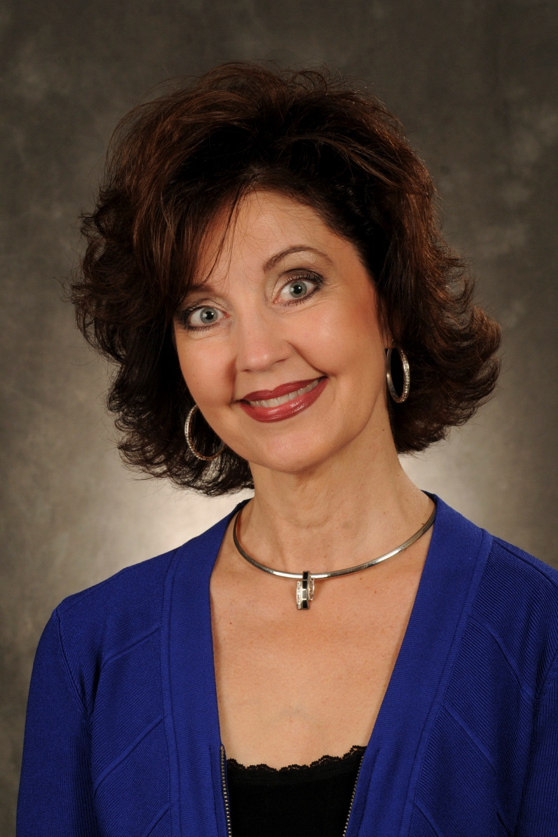
Dr. Kimberly
Childs
Dean of the College

Slide 3
Department of
Biology

Slide 4
Department of
Chemistry & Biochemistry

Slide 5
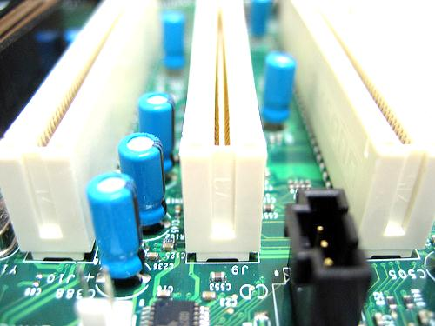
Department of
Computer Science

Slide 6
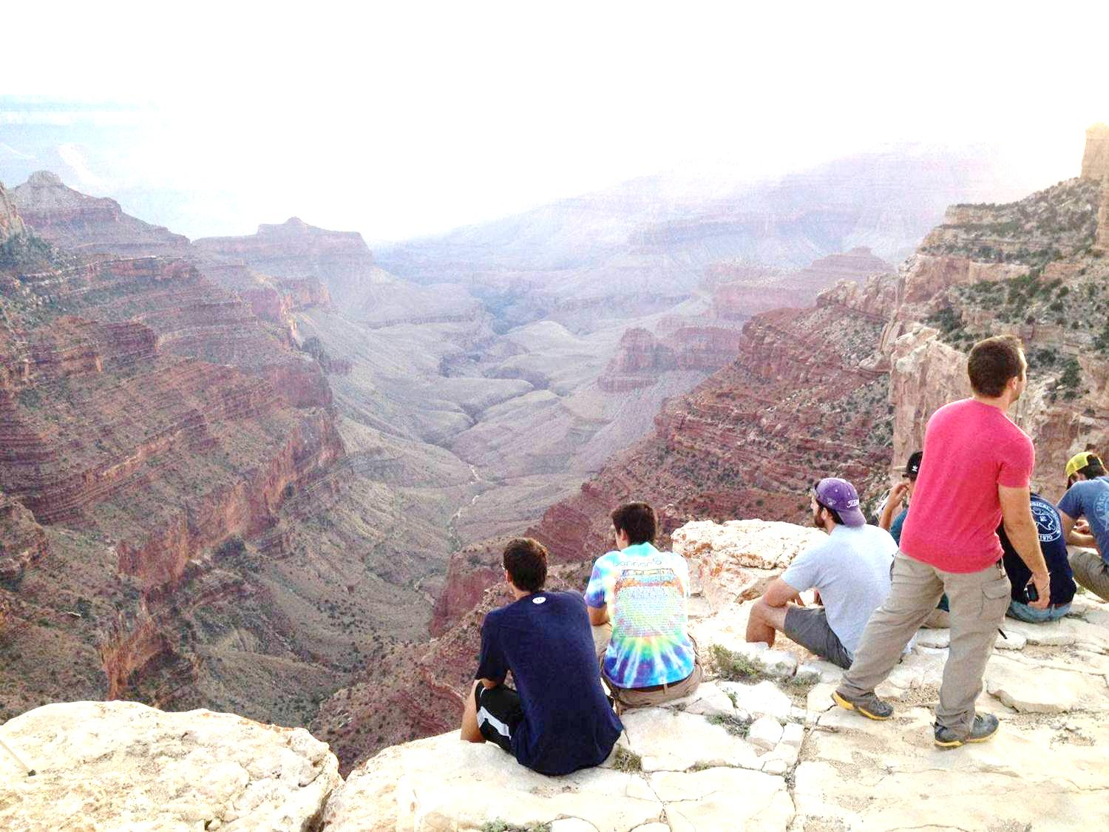
Department of
Geology

Slide 7
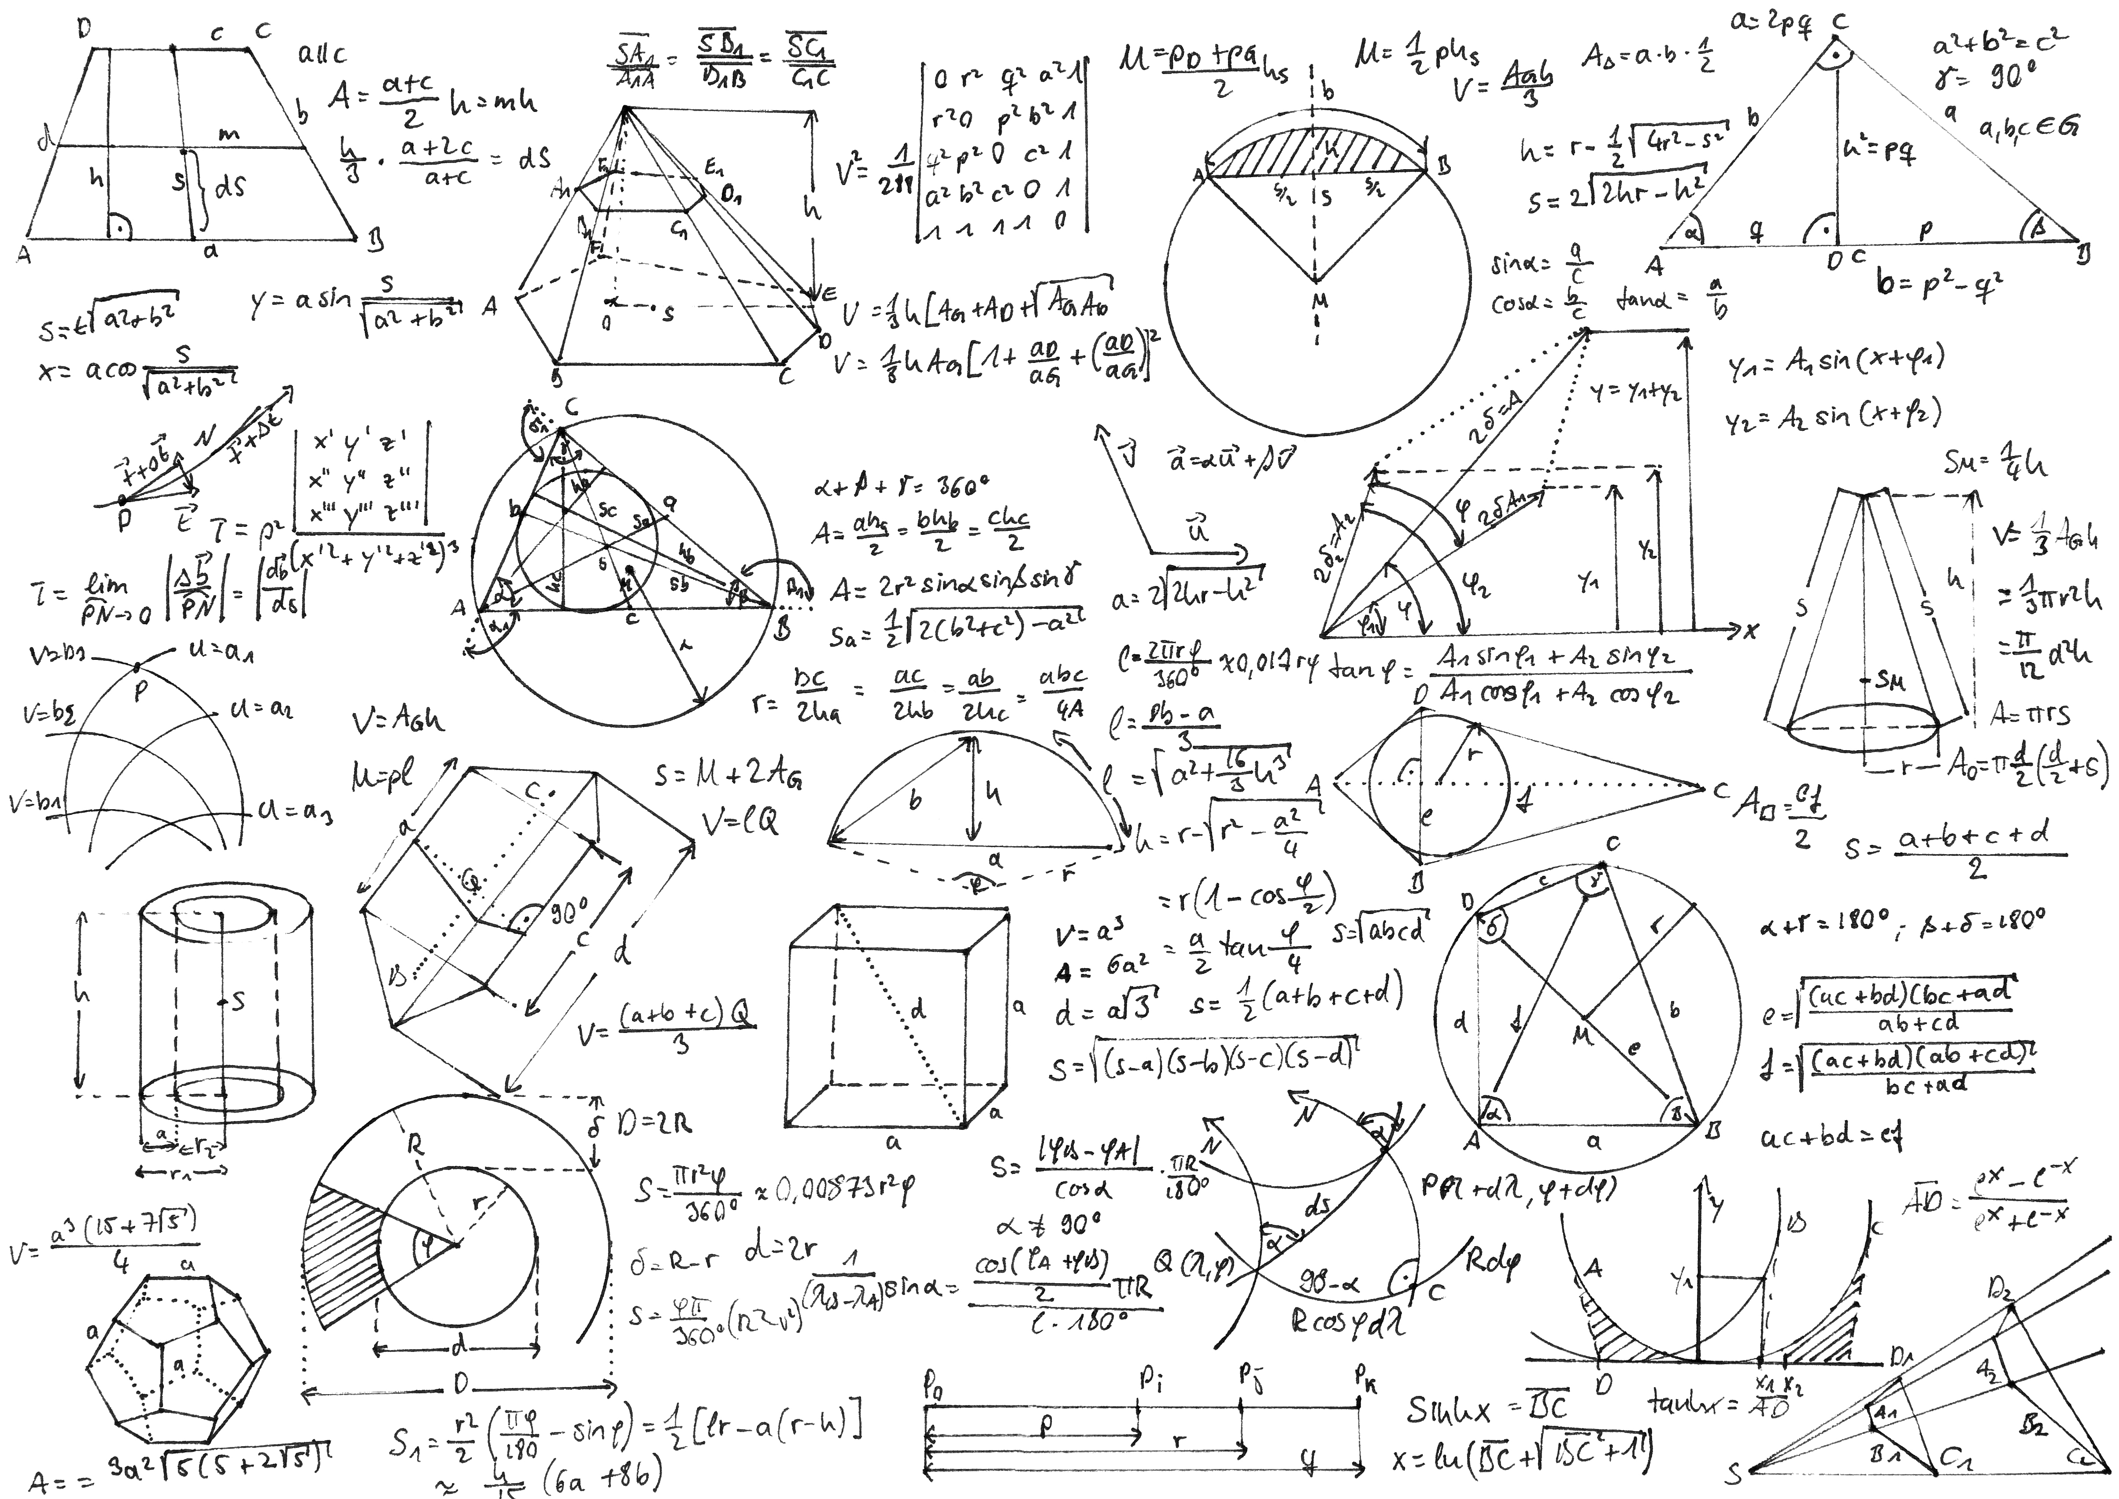
Department of
Mathematics
& Statistics

Slide 8
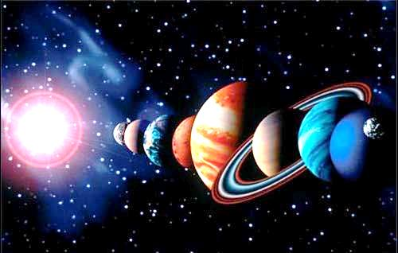
Department of
Physics & Astronomy

Slide 9
School
of
Nursing

Slide 10
Convocation:
What to expect
4:00-4:30 whole group Kennedy
4:30-5:15 meet the Departments see map
5:15-6:00 meet the student clubs Kennedy
pizza & prizes

Slide 11
Convocation:
What to expect
4:00-4:30 whole group Kennedy
4:30-5:15 meet the Departments see map
5:15-6:00 meet the student clubs Kennedy
pizza & prizes
tickets

Slide 12
CareerCast: Jobs Rated 2013
Actuary median income $88,000
projected job growth 27%
Biomedical Engineer
median income $82,000
projected job growth 62%
Software Engineer
median income $91,000
projected job growth 30%

Slide 13
/ Boston.com
Best jobs in the year 2016
Network systems analyst
53% job growth
2. Personal and Home Care
51% job growth
3. Home Health Aides
49% job growth
4. Software engineers
46% job growth
5. Veterinary Technologists & Technicians 41% job growth

Slide 14
100 Best Jobs
Dentist
Registered Nurse
Pharmacist
Computer Systems Analyst
Physician
Database Administrator

Slide 15
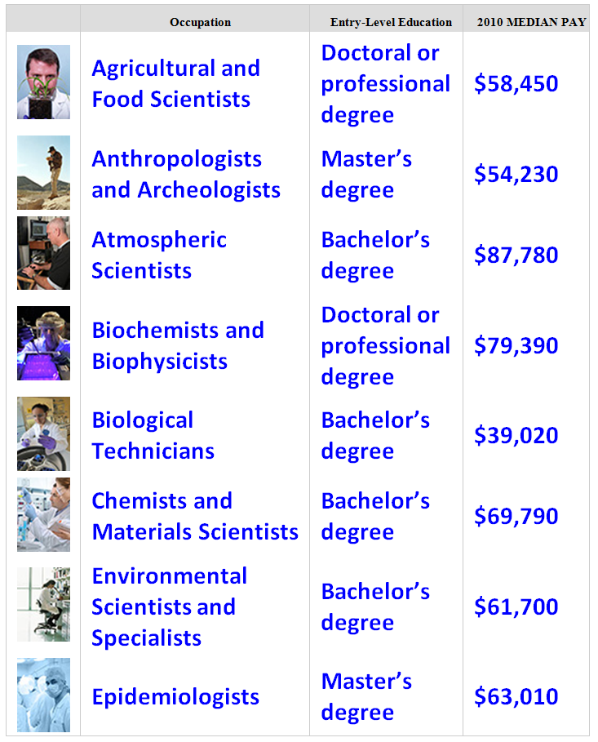
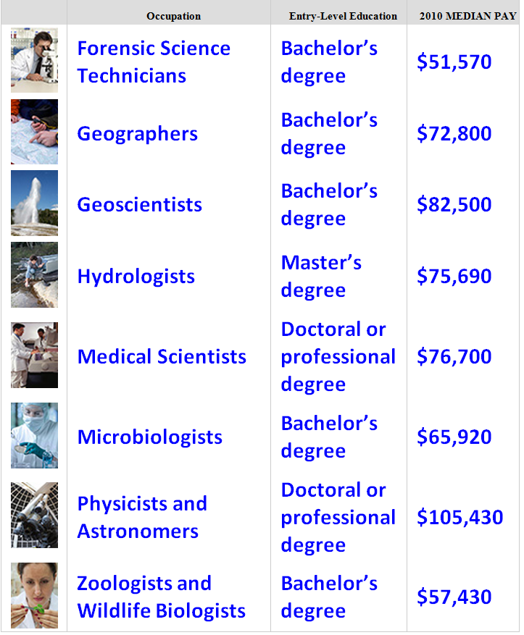

Slide 16
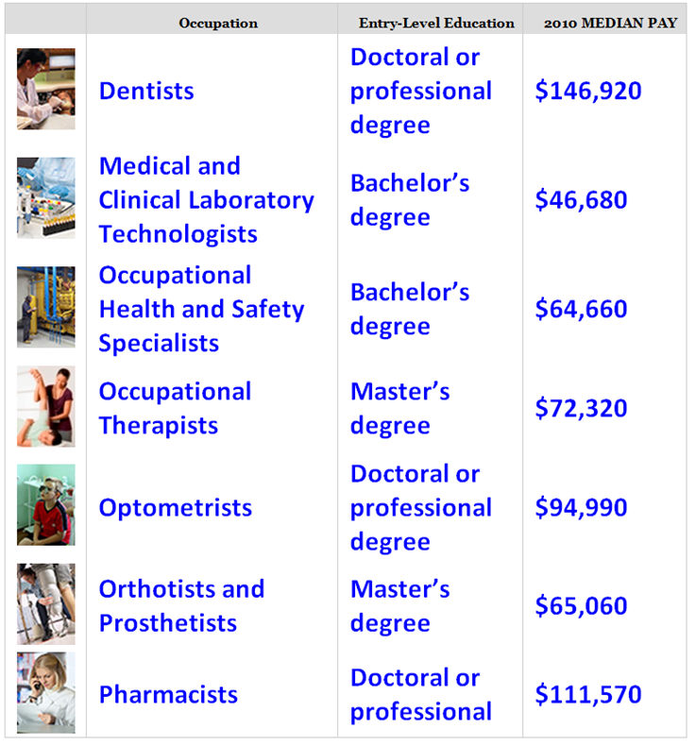
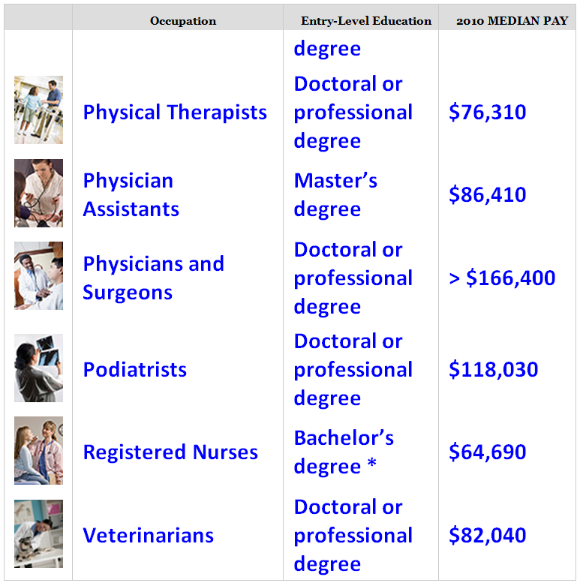

Slide 17
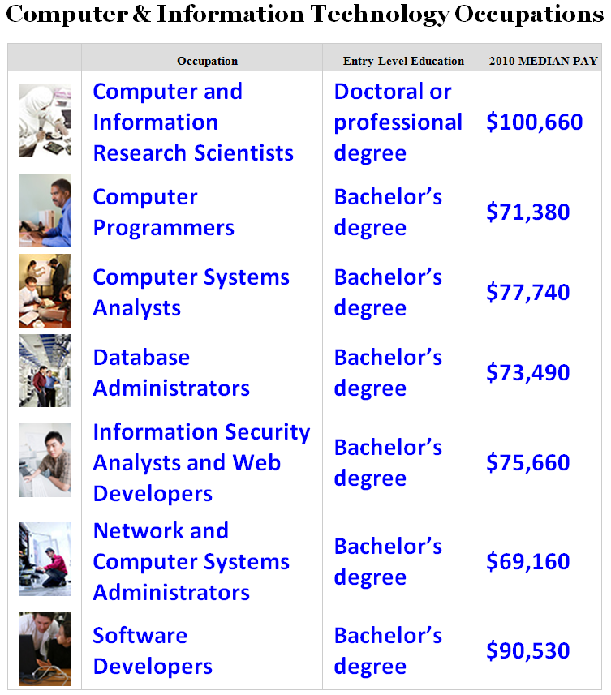
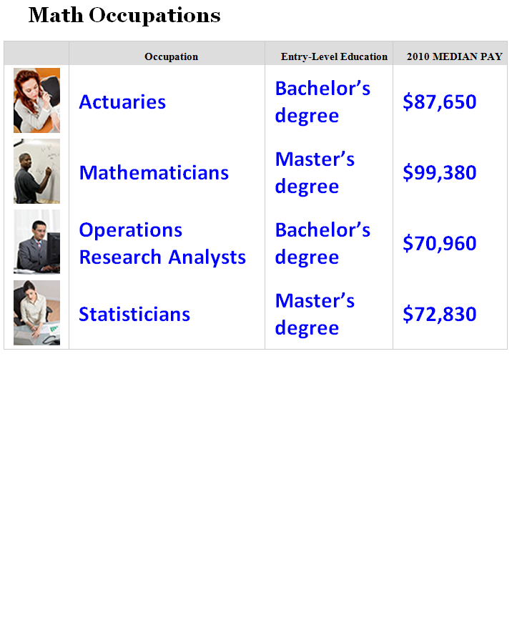
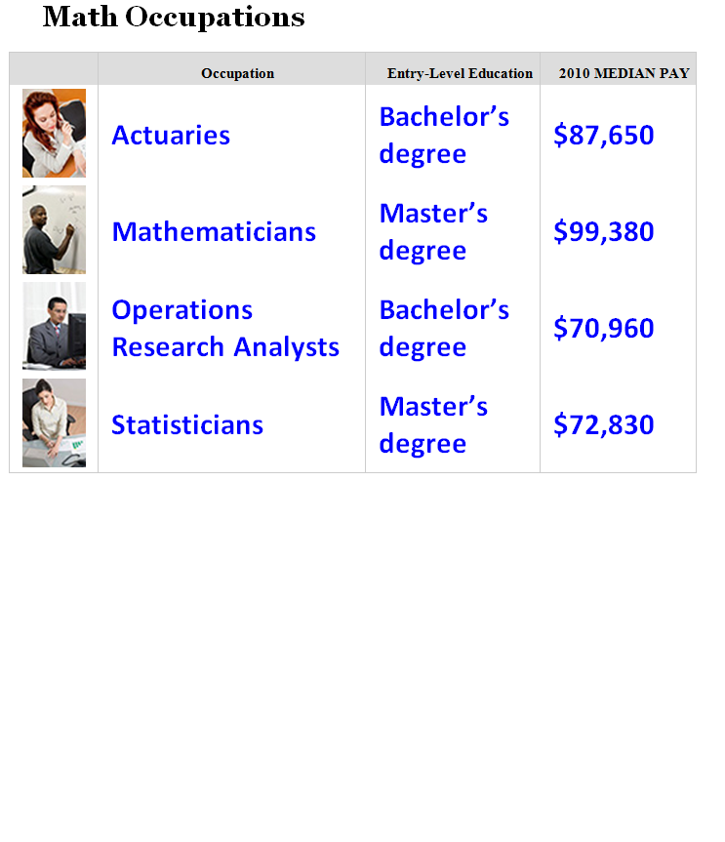

Slide 18
Impact Lives!
My 8th grade algebra teacher encouraged me to work beyond what I thought my limitations were. He didn’t let me give up. It changed my life.
- Stacia

Slide 19
Impact Lives!
After my son’s accident, our nurse’s expertise made an intolerable situation bearable. I’m so thankful for her.
- Lesa

Slide 20
Key points from Those who Know
You have to get advised before you can register for classes.
Don’t ever park backward in a parking spot.
Don’t be afraid to ask questions.

Slide 21
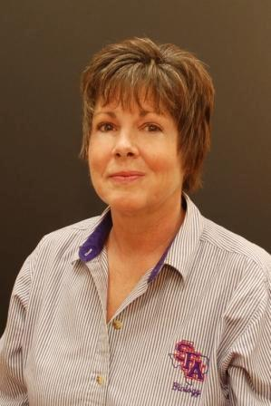
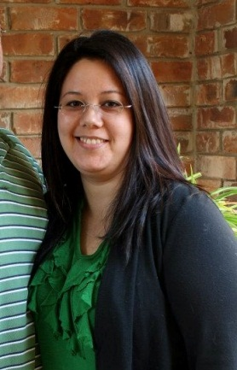
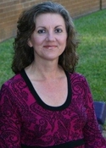
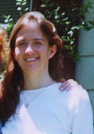
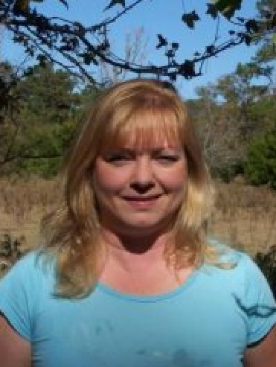
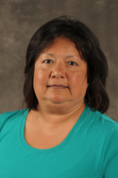
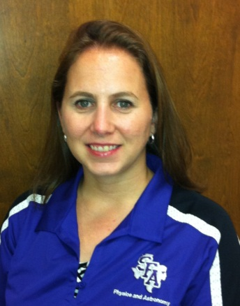
If you don’t know your advisor…
Laura Anderson,
Biology
Carrie Stover, Chemistry & Biochem
Donna Rocka,
Computer Science
Shawna Scott,
Geology
Judeana Marshall,
Math & Statistics
Rosemary Juarez,
Nursing
Kelly Kahlden,
Physics & Astronomy

Slide 22
Key points from Those who Know
You have to get advised before you can register for classes.
Don’t ever park backward in a parking spot.
Don’t be afraid to ask questions.

Slide 23
Key points from Those who Know
You have to get advised before you can register for classes.
Don’t ever park backward in a parking spot.
Don’t be afraid to ask questions.

Slide 24
Off to departments!
(don’t forget your map)

